Slide 1
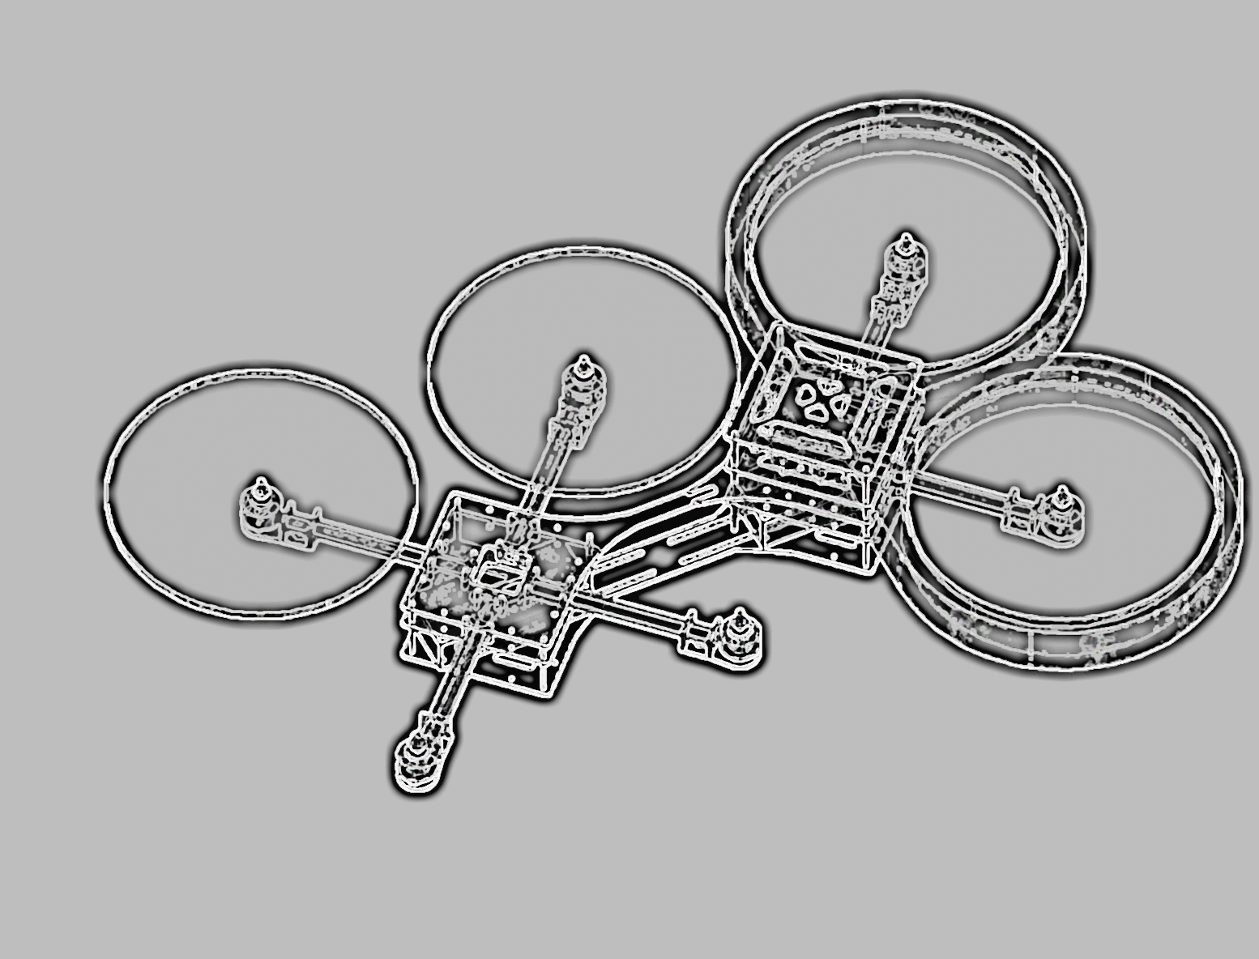

Integrated Project
Fall Semester 15/16
University of Applied Sciences Ulm
X-COPTER

Slide 2

The X-Copter Project: Table of Content
University of
Applied Sciences
Table of Content
Overview
Project Management
System Architecture
Hardware
Linux
Flight Controller
Challenges
Conclusion
Lessons Learned

Slide 3
The X-Copter Project: Overview
University of
Applied Sciences
Introduction
TEXTtextTEXT
Gjfh
ghgn

Slide 4
The X-Copter Project: Overview
University of
Applied Sciences
Initial state of the Project
TEXTtextTEXT

